Slide 1


Georgia Community Model Building
US Environmental Protection Agency
We’re creating tools for communities to use in evaluating how technological improvements in local industries, utilities and logistics can reduce carbon footprints, and other adverse impacts, to protect the environment while creating jobs and new business opportunities.
Research Partner: Dr. Valerie Thomas (ISyE) Georgia Tech Summer Internships Community Material Flow Analysis
New Technology Scenario Analysis
May 18 to Aug 7, 2020. Bachelors degree required.

Slide 2
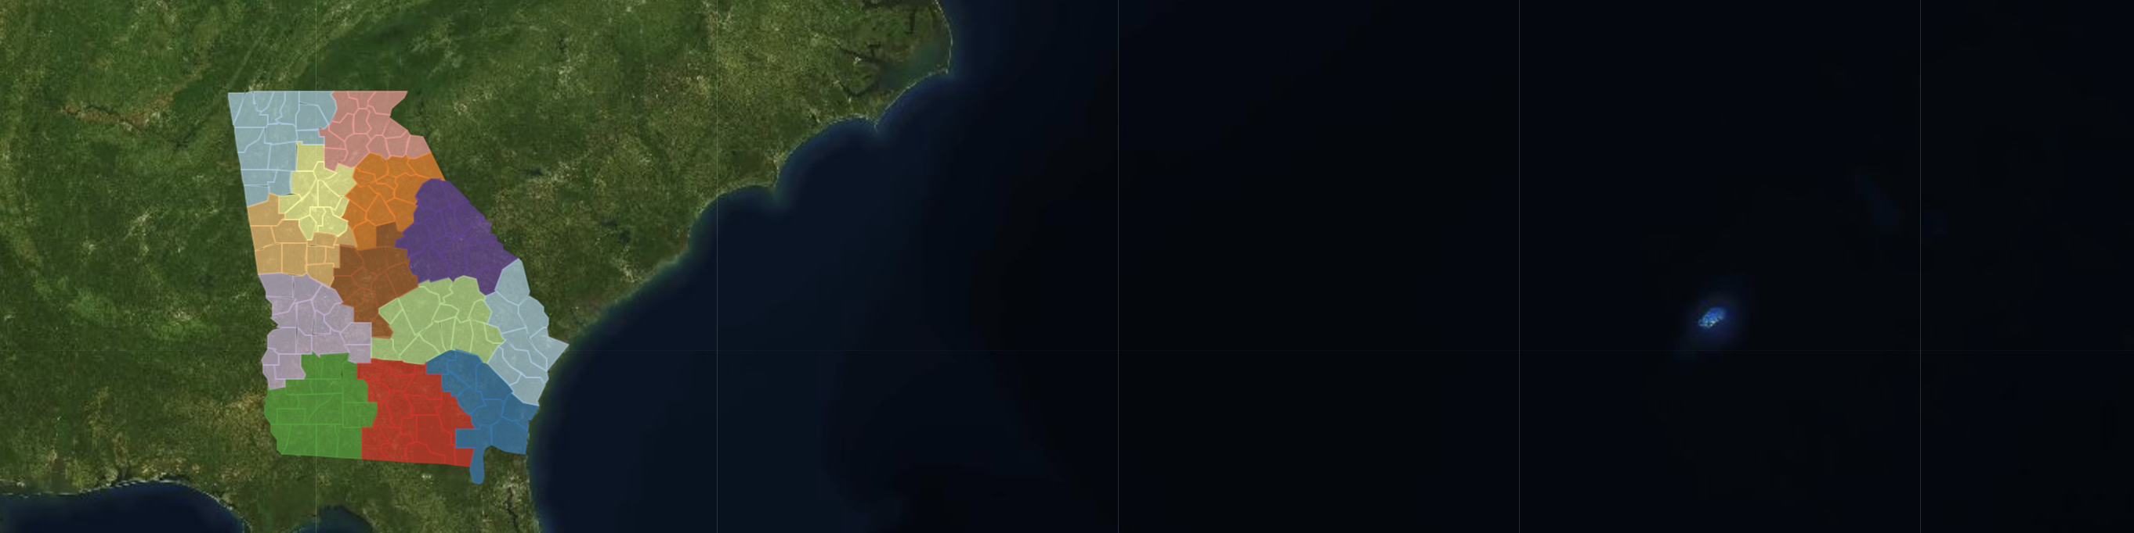
2020 Georgia Summer Internships
Georgia’s flagship projects with the EPA
Regional Sustainability and Environmental Sciences Research Program (RESES)
Community-Driven Application Development using USEEIO Models
US Environmental Protection Agency
Georgia is the first state to implement the US Environmentally-Extended Input-Output (USEEIO) model. Companies like Amazon are already using the EPA’s USEEIO API to set their net zero carbon footprint goals. Our material flow intern will process community data using Python to create interactive supply chain visualizations. Our technology scenario intern will build R Language tools to convey industry purchases, resource use and emissions.

